Slide 1


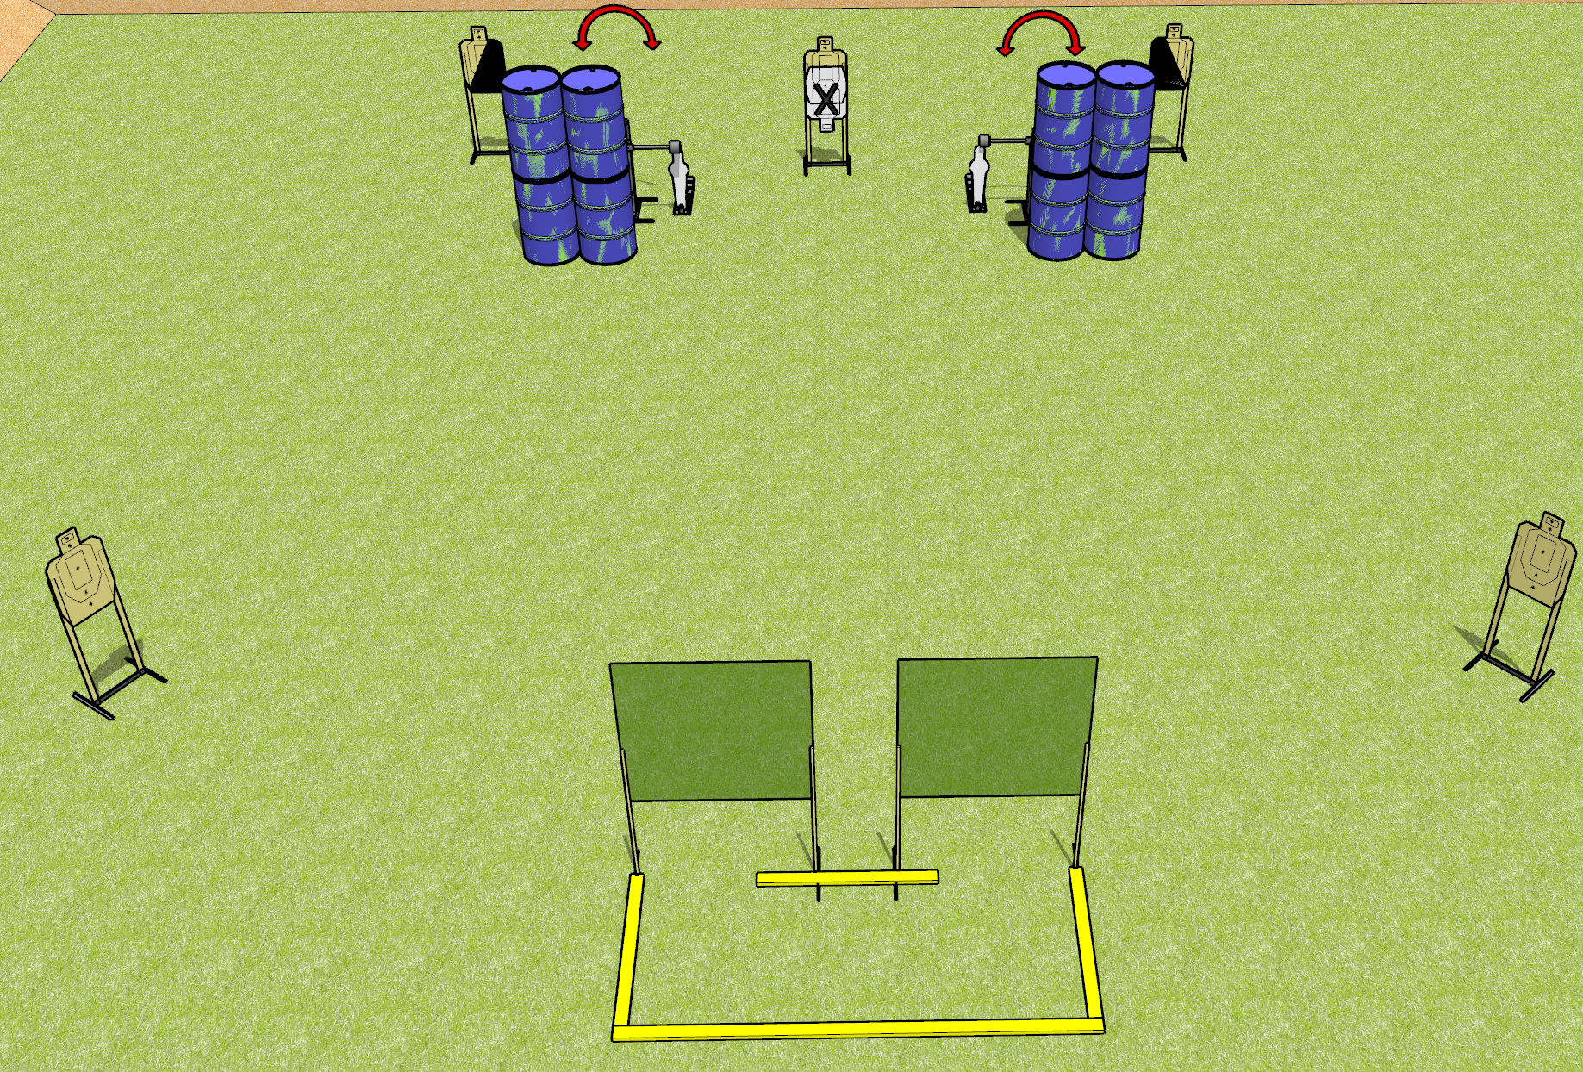
 | Dothan Gun Club – USPSA Match Symmetry Course Designer : Drew Coleman
Round Count 16 rounds 7 USPSA 2 mini poppers
Equipment List 4 wall feet 3 small fault lines 2 swingers 1 left + 1 right diag

Slide 2
Symmetry
Written Stage Briefing
Symmetry is a 16 round, 80 point, Comstock course of fire. There are 7 USPSA targets and 2 steel. The best 2 hits on cardboard will score and steel must fall to score.
Handgun start position is anywhere inside the shooting area, wrists below belt. Handgun is loaded and holstered.
PCC start position is anywhere inside the shooting area, stock on belt. Loaded carbine is held with both hands, safety on.
On the audible start signal, engage targets as they become available from within the shooting area.

Slide 3
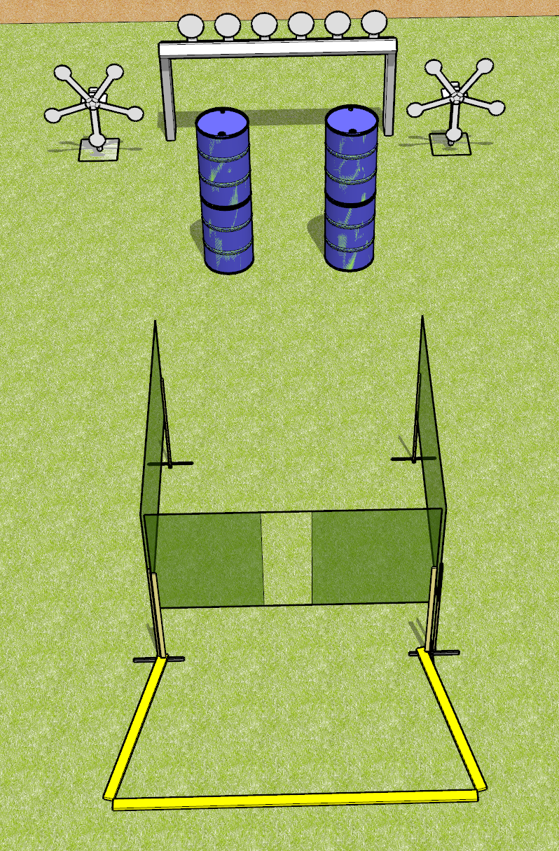
 | Dothan Gun Club – USPSA Match Steely Course Designer : Drew Coleman
Round Count 20 rounds 20 plates
Equipment List Plate rack 2 Texas stars 2 medium fault lines

Slide 4
Steely
Written Stage Briefing
Steely is a 20 round, 100 point, Comstock course of fire. There are 20 falling plates. Steel must fall to score.
Handgun start position is anywhere completely outside the shooting area, wrists below belt.. Handgun is loaded and holstered.
PCC start position is anywhere completely outside the shooting area, stock on belt. Loaded carbine is held with both hands, safety on.
On the audible start signal, engage targets as they become available from within the shooting area.

Slide 5
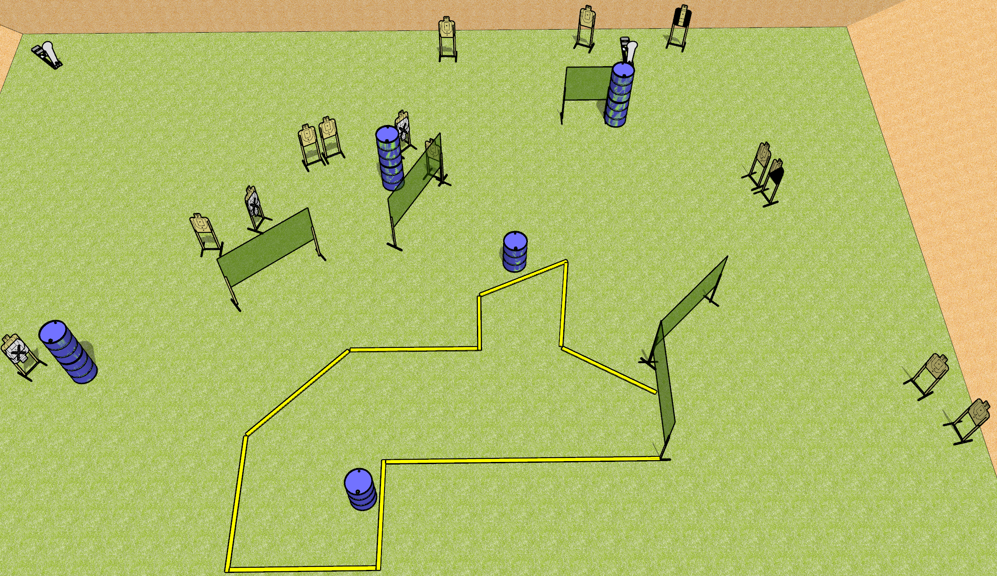
 | Dothan Gun Club – USPSA Match Pick em Up Course Designer : Patrick Free
Round Count 30 rounds 14 USPSA 2 colt poppers
Equipment List 1 tux + 1 right diag 10 wall feet

Slide 6
Pick em Up
Written Stage Briefing
Pick em Up is a 30 round, 150 point, Comstock course of fire. There are 14 USPSA targets and 2 steel. The best 2 hits on cardboard will score and steel must fall to score.
Start position is anywhere inside the shooting area, fingers touching ears.
Firearm is on either barrel unloaded, pointed down range. All magazines to be used start on other barrel.
On the audible start signal, engage targets as they become available from within the shooting area.

Slide 7
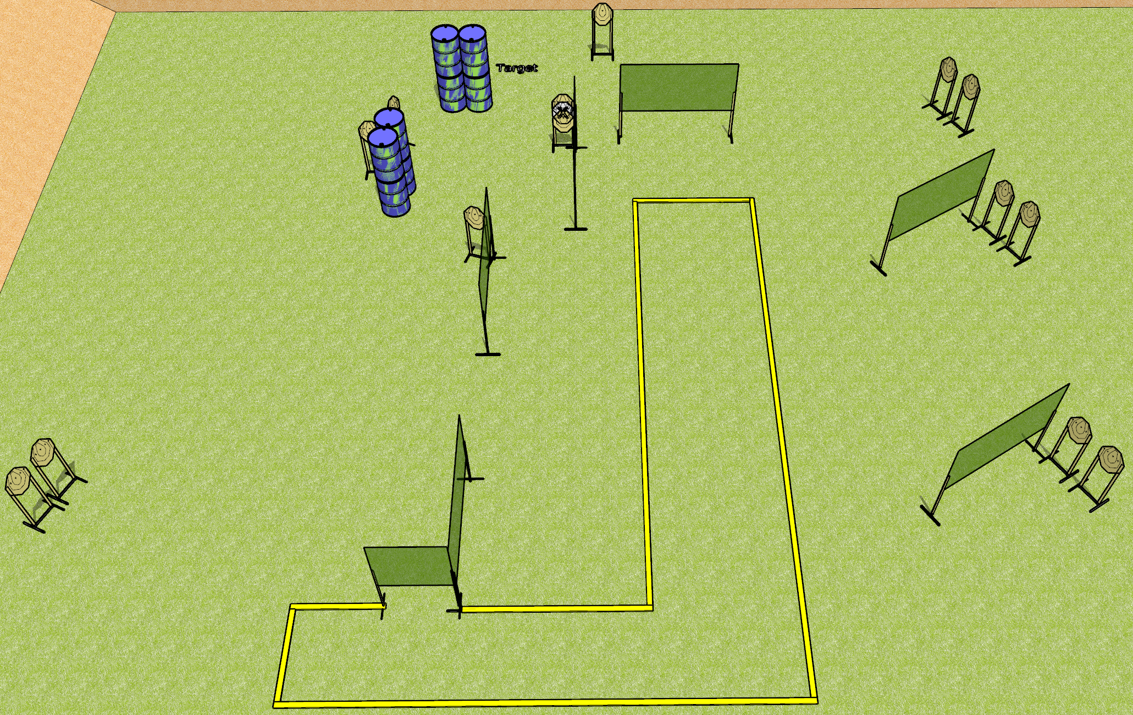
 | Dothan Gun Club – USPSA Match Some Stage Course Designer : Drew Coleman
Round Count 30 rounds 15 IPSC
Equipment List 13 wall feet 2 medium fault lines

Slide 8
Some Stage
Written Stage Briefing
Some Stage is a 30 round, 150 point, Comstock course of fire. There are 15 IPSC targets. The best two hits on cardboard will score.
Handgun start position is anywhere inside the shooting area, wrists below belt. Handgun is loaded and holstered.
PCC start position is anywhere inside the shooting area, stock on belt. Loaded carbine is held with both hands.
On the audible start signal, engage targets as they become available from within the shooting area.

Slide 9
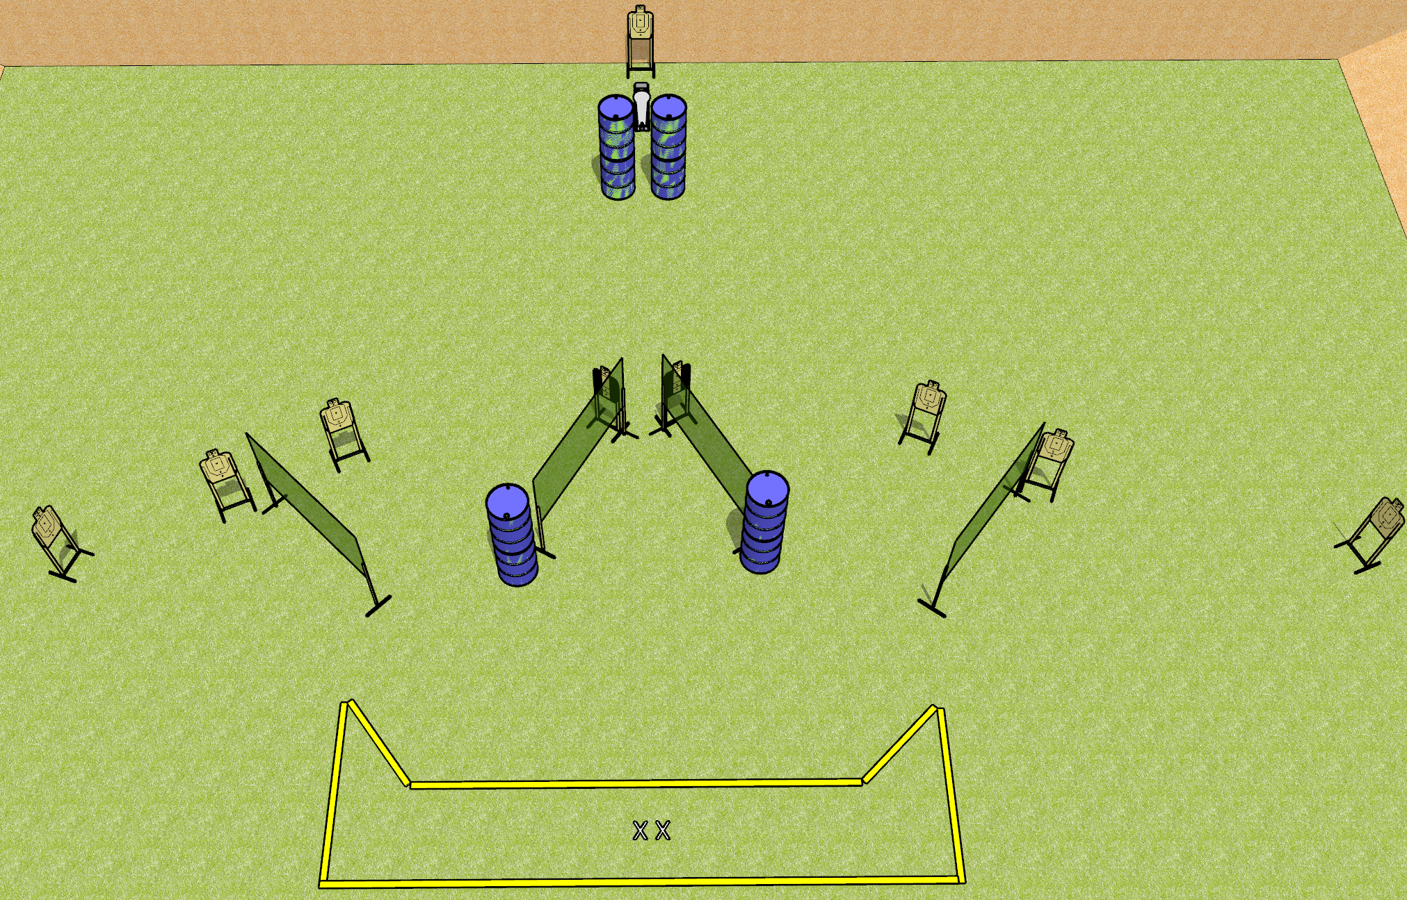
 | Dothan Gun Club – USPSA Match Overtime Course Designer : Patrick Free
Round Count 9 USPSA 1 colt
Equipment List 2 medium fault lines 2 tuxedos

Slide 10
Overtime
Written Stage Briefing
Overtime is a 28 rounds, 140 point, Comstock course of fire. There are 9 USPSA targets and 1 steel. The best 3 hits on cardboard will score, and steel must fall to score.
Handgun start position is feet on X’s, wrists below belt. Handgun is loaded and holstered.
PCC start position is feet on X’s, stock on belt. Loaded carbine is held with both hands.
On the audible start signal, engage targets as they become available from within the shooting area.

